Slide 1
GYM MANAGEMENT SYSTEM
Hassan anwar-18072

Slide 2
Languages and Frameworks
Python
Django
HTML
CSS
Javascript
Database: MySQL

Slide 3
PROBLEM
Coronavirus global pandemic has turned the fitness industry upside down almost overnight.
In 2020, gym owners have received cancellation requests, a drop in sales and package repurchases.
With rentals and salaries to pay, and no revenue to speak of, many gyms have shut down.
There have been thousands of job losses.
Many fitness coaches and support staff were sent on leave without pay or reduced pay.

Slide 4
THE 2020 REVOLUTION IN THE FITNESS INDUSTRY
New consumer behavior have emerged in 2020 that rely on the internet to maintain human connection and interaction.
As the worldwide lockdown forces consumers to comply with social distancing rules, the home has become the new central stage for everything from eating and socializing to working and working out.
Companies that were once running high-touch operations have found creative ways to bring business online and into customers’ homes, and the fitness industry is no exception.
Sales of home gym equipment have skyrocketed in 2020. Lockdown inspired people to improve their home gyms and invest in home fitness equipment.
A study finds that fitness apps’ downloads grew by nearly 50% during the first half of 2020.
According to a survey, 59% of Americans say they don’t plan on renewing their gym memberships once the pandemic is over.

Slide 5
WHY HAVE A GYM MANAGEMENT SYSTEM IN POST-PANDEMIC WORLD?
Virtual fitness is here to stay for the following reasons:
Gyms and studios that did not have a digital presence and could not be discovered online can now market their business online by going digital.
Onsite gym facility comes with the drawback of limited capacity inside the premise.
The cost of setting up a virtual gym is very low as compared to setting up an onsite gym or expanding your fitness business by opening another branch.
By offering an online service, you become available for subscription to every person with an internet connection, no matter in what part of the world they are!
Build a name around the globe by hiring famous fitness coaches from different parts of the world.
Provide free trials online to potential members. It may be risky to allow free trials to the general public inside an onsite gym, as it can get overcrowded.

Slide 6
ABOUT OUR GYM MANAGEMENT SYSTEM
Our gym management system is a web application.
There are two types of persons that can create their account: members and fitness instructors.
There are three types of services offered: class, on-demand videos package, and diet plan.
A fitness instructor can create and offer any of these three types of services.
A member can get access to any of these three types of services.

Slide 7
Visual Representation Of Types Of Services Offered On Our Web Application

Slide 8
SERVICE
ON-DEMAND VIDEOS PACKAGE
CLASS
DIET PLAN
ONE-ON-ONE
GROUP
ONSITE
ONSITE
A class can be a private (one-on-one) training session with a personal trainer, or a group workout session hosted by an instructor.
Both types of session can be online or onsite.
ONLINE
ONLINE

Slide 9
Visual Representation Of The Workflow

Slide 10
CLASSES
INSTRUCTOR
Creates or Deletes
Subscribes or Unsubscribes to
MEMBER
VOD PACKAGES
DIET PLANS

Slide 11
DETAILS OF WORKFLOW
The application has two types of users and therefore different interfaces for each.
The member’s interface:
Allows the member to search for a service. They can enter their preferences to apply filter to the search results and view only those services that are closest to their preference.
Show member the details of services they currently have access to.
Provides link to live stream sessions, VOD packages, and diet plans.
The instructor’s interface:
Allows the instructor to create a service that can be a live stream session, VOD package, or diet plan.
Allows the instructor to delete (stop offering) a service.
Show the instructor all the services they are currently offering at your gym.

Slide 12
HOW DOES MEMBER GET ACCESS TO EACH SERVICE?
Member cannot access any service until and unless they have paid for it.
For a live stream session, members get access to a zoom link that directs them to the session.
For a VOD package, members get access to a private YouTube playlist that has all the recorded workout videos.
For a diet plan, members get access to a link that directs them to a page containing all the details of the diet plan.

Slide 13
TOOLS EMPLOYED TO CREATE THE WEB APPLICATION
Tools used for frontend: HTML, CSS, JavaScript, Bootstrap.
Tools used for backend: MySQL, Python, Django.

Slide 14
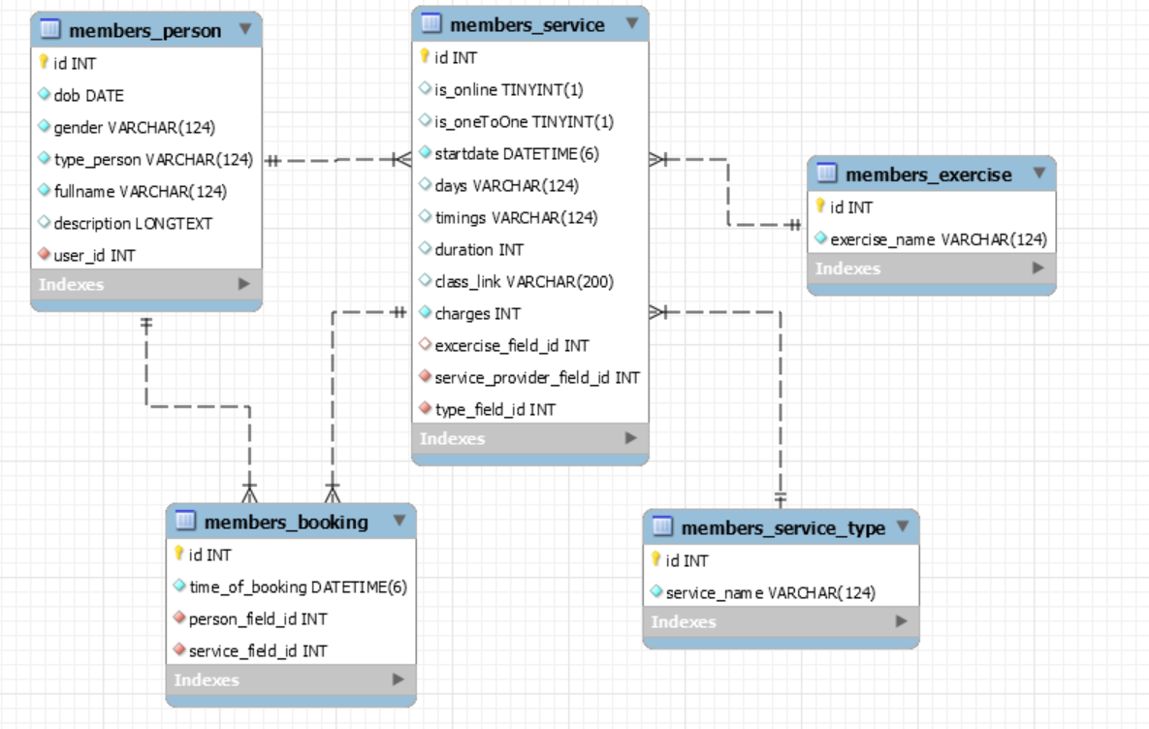
ERD

